Slide 1

Shield Insurance Analysis
Sunitha Madhavadhas

Slide 2
Project Goal
Focused on analyzing Shield Insurance’s performance across major cities
Identify insights to optimize investment strategies

Slide 3
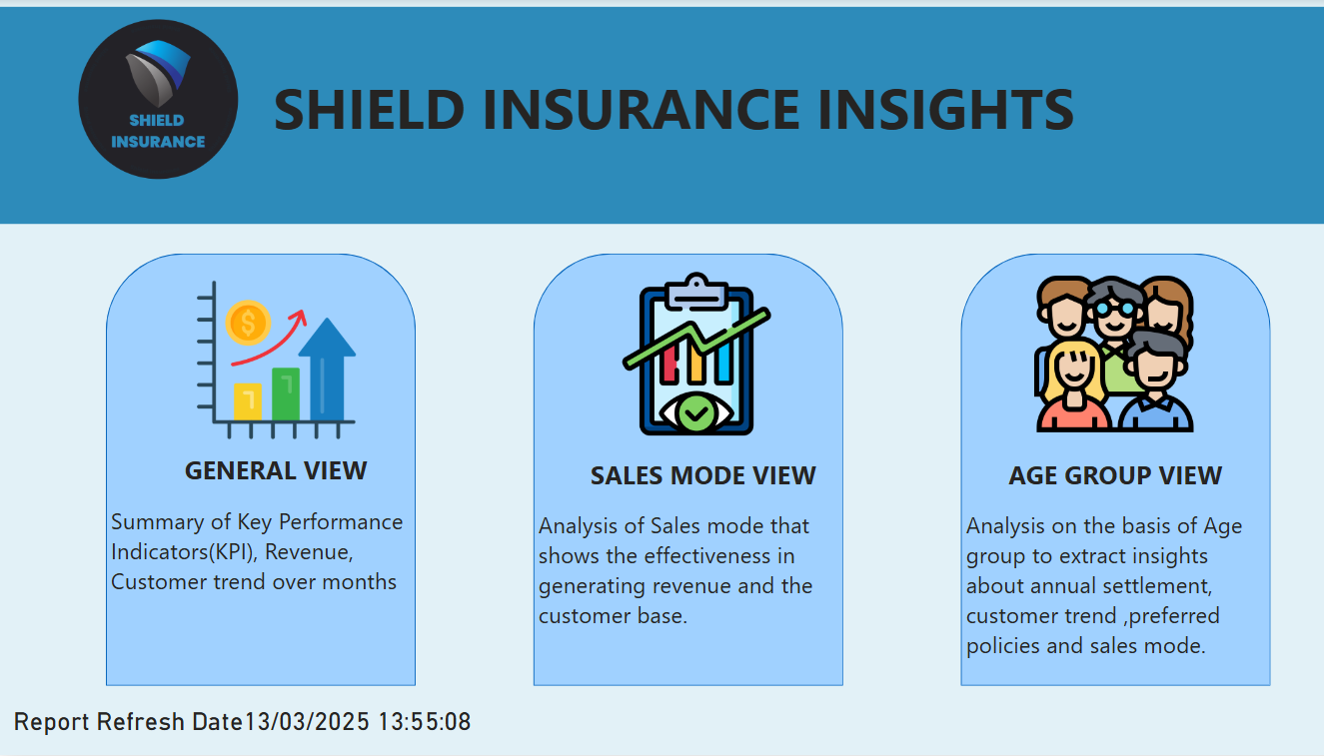

Slide 4
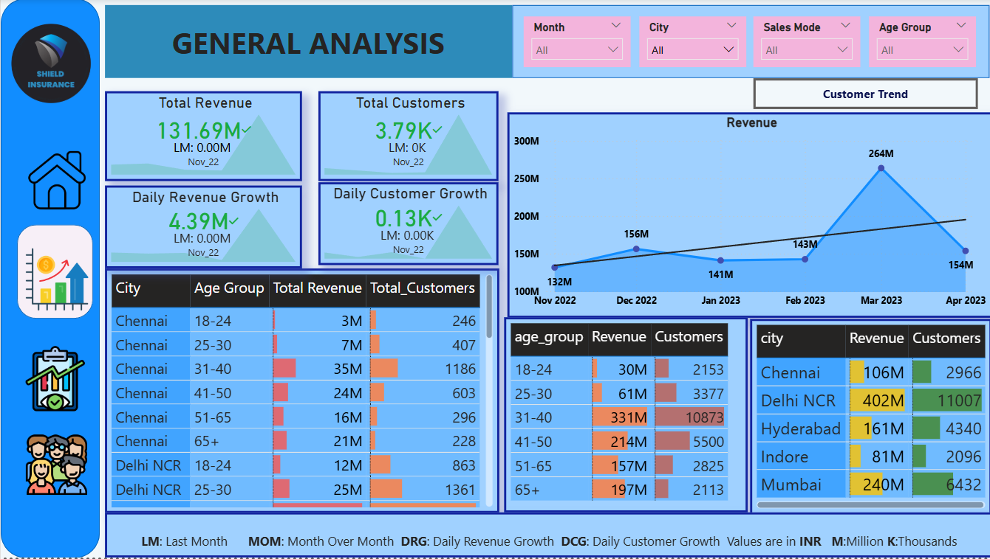

Slide 5
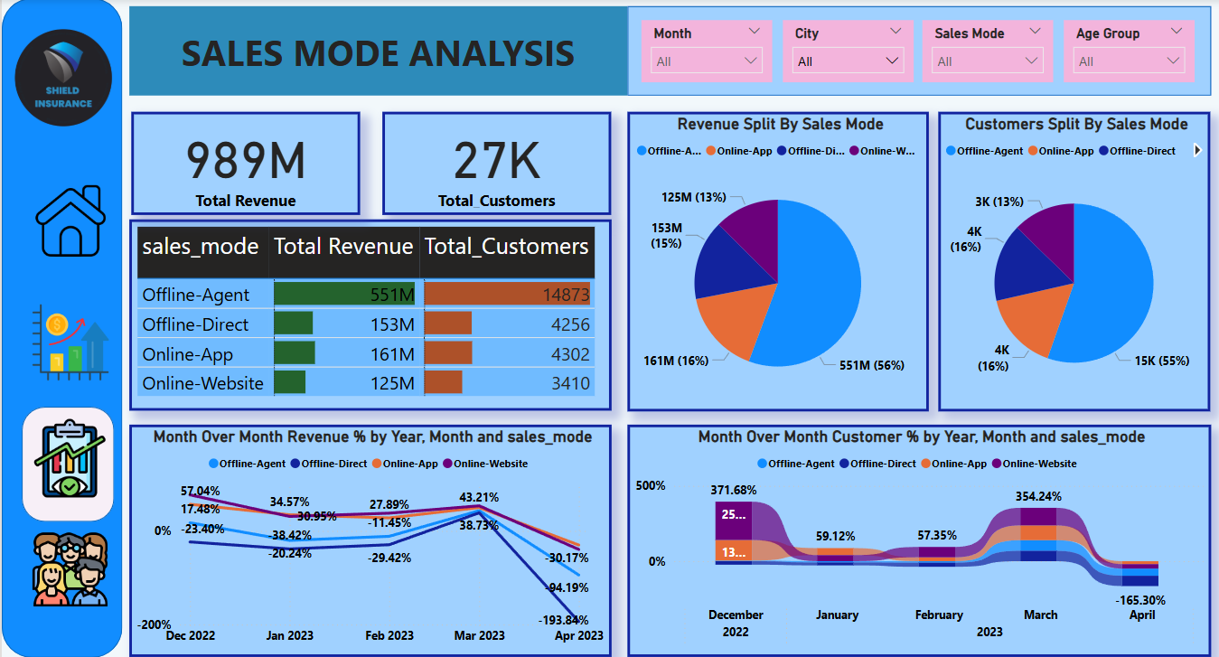

Slide 6
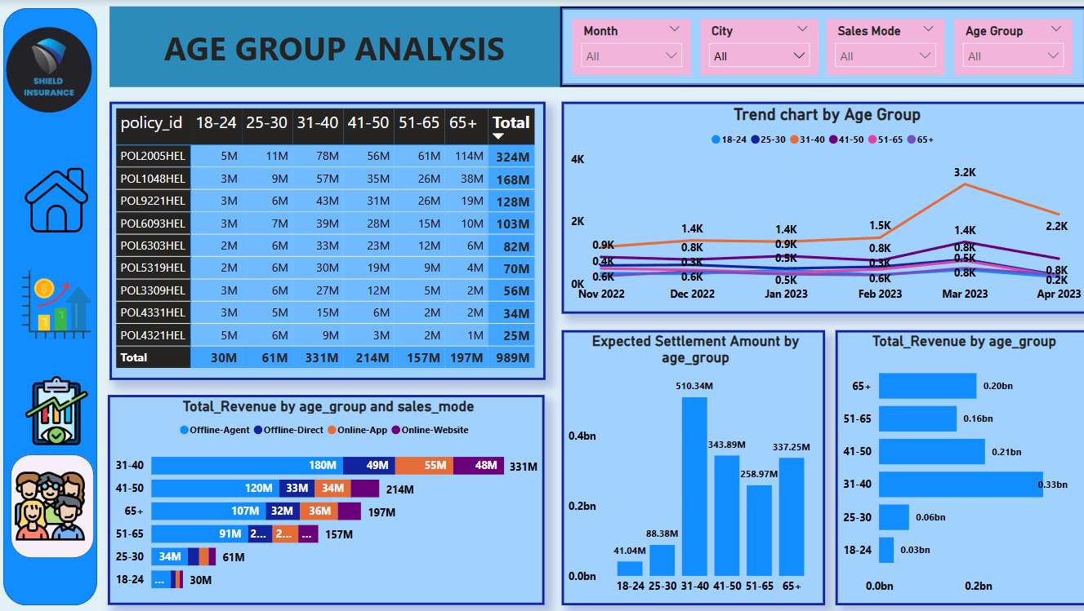

Slide 7
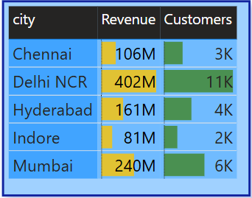
City Analysis
Insights:
Delhi NCR leads in both revenue (₹402M) and customers(11K)
Indore has the lowest revenue (₹81M) and customer base (2K)
Mumbai shows solid performance with ₹240M revenue and 6K customers.
Recommendations:
Focus marketing efforts to strengthen dominance in Delhi NCR.
Develop targeted campaigns to boost presence in Indore.
Invest in Mumbai to expand the existing customer base.

Slide 8
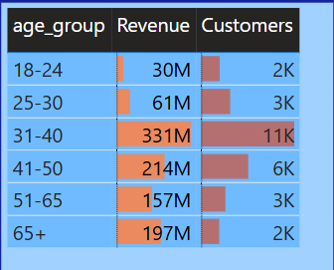
Age group Analysis
Insights:
31-40 age group drives the highest revenue (₹331M) and customer base (11K)
65+ age group shows high revenue potential (₹197M) despite fewer customers
18-24 group contributes the least (₹30M)
Recommendations:
Strengthen engagement with the 31-40 group.
Promote high-value policies to the 65+ segment.
Launch targeted campaigns to attract younger customers.

Slide 9
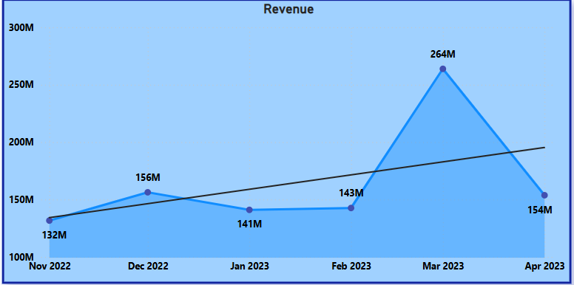
Monthly Trend Analysis
Insights:
March 2023 recorded the highest revenue peak at ₹264M, indicating a strong seasonal trend or promotional impact.
November 2022 had the lowest revenue at ₹132M, suggesting weaker performance during that period.
Despite fluctuations, the overall trend shows a gradual upward trajectory, highlighting improving business performance.
Recommendations:
Investigate the factors driving the March 2023 peak to replicate success.
Analyze the November 2022 dip to identify potential issues or missed opportunities.
Implement strategies to maintain consistent revenue growth throughout the year.

Slide 10
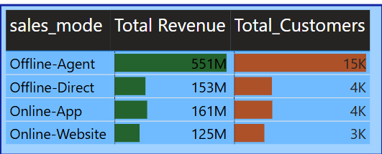
Sales Mode Analysis
Insights:
Offline Agents dominate with the highest revenue (₹551M) and largest customer base (15K) — the most effective sales channel.
Online App outperforms Online Website in both revenue (₹161M) and customer base (4K vs. 3K**) — indicating stronger user preference for mobile platforms.
Offline Direct performs moderately with ₹153M revenue and 4K customers.
Recommendations:
Continue investing in Offline Agent strategies to maintain dominance.
Enhance the Online App experience to capitalize on its stronger performance.
Explore improvements in the Online Website platform to boost engagement

Slide 11
Recommendations
Customer Growth: Develop targeted marketing campaigns to attract and retain customers.
Revenue Optimization: Explore strategies to increase revenue from the 65+ age group.
Market Focus: Capitalize on the strong market presence in Delhi and explore growth opportunities in Mumbai.

Slide 12
Thank You

